Slide 1
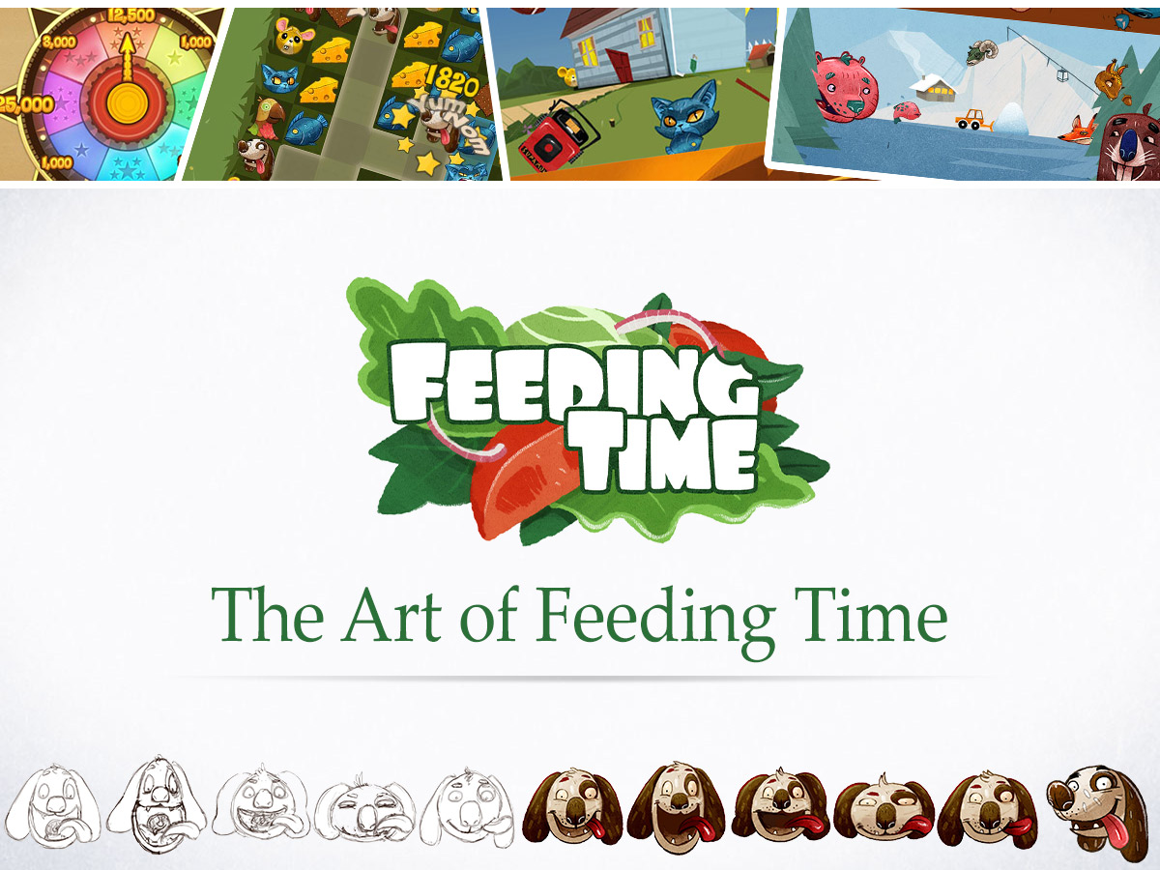

Slide 2
Overview
Incubator Games
What is Feeding Time
Freelance Artists
Visual Iteration
Promotional Content
Final Takeaways
Notes:
This might all be old news to some of you, but hopefully there’ll be at least an amusing anecdote or two in there. In general, I tried to create a talk filled with the kind of info I would’ve found interesting and useful before we had begun Feeding Time.

Slide 3

Incubator Games
Notes:
Splash for IG Section

Slide 4
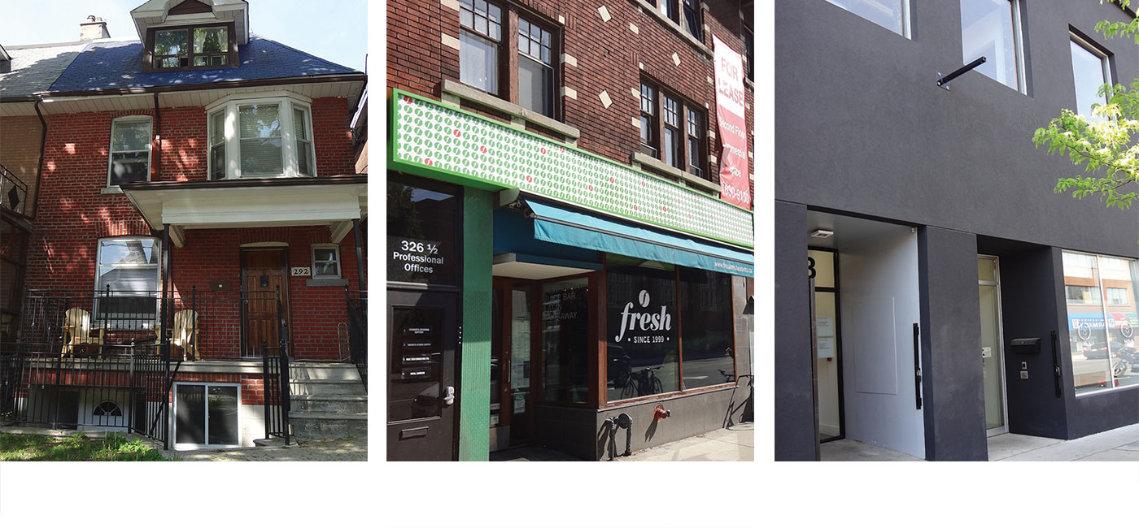
Incubator Games
2010
2012
2013
Incubator Games
(not Games Incubator)
Founded in Toronto in 2010 by 3 Former Capybara Games Employees
7 Full-Time Employees, Various Freelancers
Notes:
Name comes from an internal desire to polish and infuse games with loving touches until they’re good and ready for release.

Slide 5
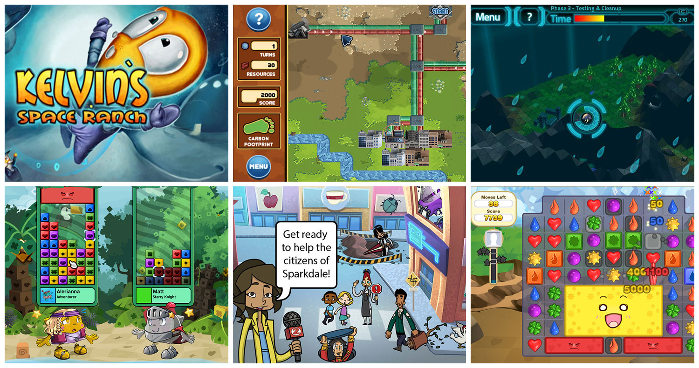
Incubator Games
Focused on Contract Work During Early Years
Notes:
Took a good couple of years doing work-for-hire to earn capital, develop industry connections, and invest in internal tools.

Slide 6
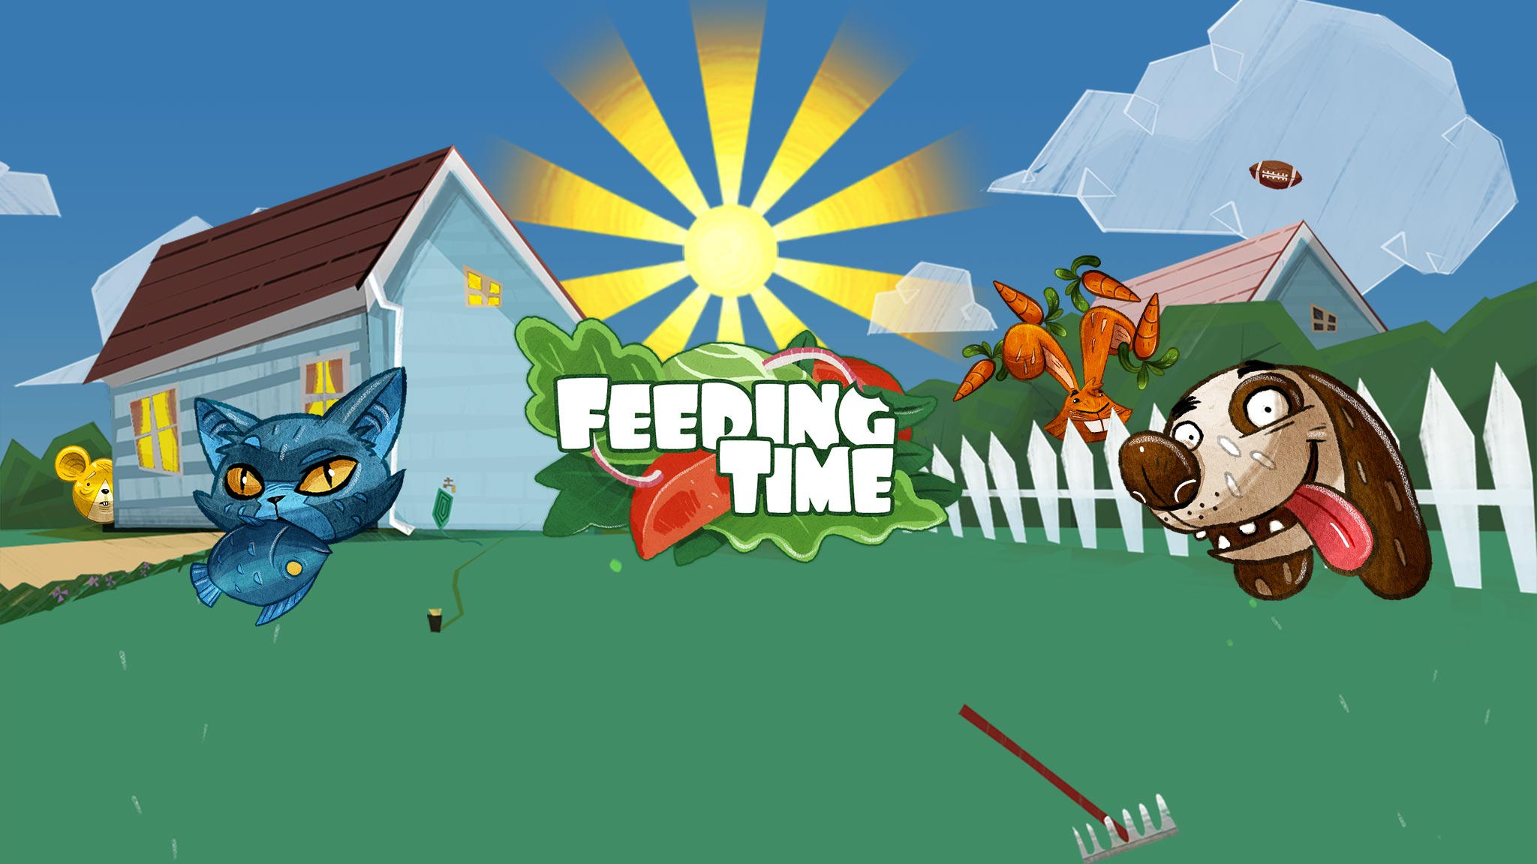
What is Feeding Time?

Slide 7

What is Feeding Time?
  First IP Goals:
  Prototyped between work-for-hire
  Designed for touch screens
  Stand out in both gameplay and visuals
  Wouldn’t severely hinder us if it made $0
Notes:
Wanted to do a mobile game due to guarantee to be published.
Change text to:
First IP Goals:
Prototyped between work-for-hire
Designed for touch screens
Stand out in both gameplay and visuals
Wouldn’t severely hinder us if it made $0

Slide 8
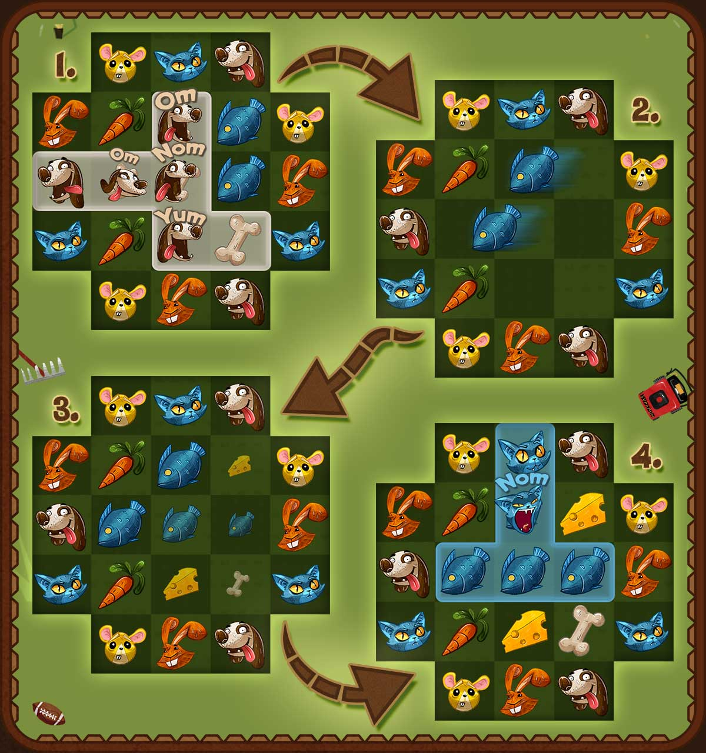
What is Feeding Time?
Notes:
A game about pairing animals with their favourite foods.
Animals are positioned on the edges of the board, while the centre is filled with a mix of foods.
1). Dogs rush out to eat all the connected bones.
2). Remaining foods slide left, the direction from which the dogs ate.
3). New foods spawn in left over gaps once sliding completes.
4). Cats eat newly connected fish.

Slide 9
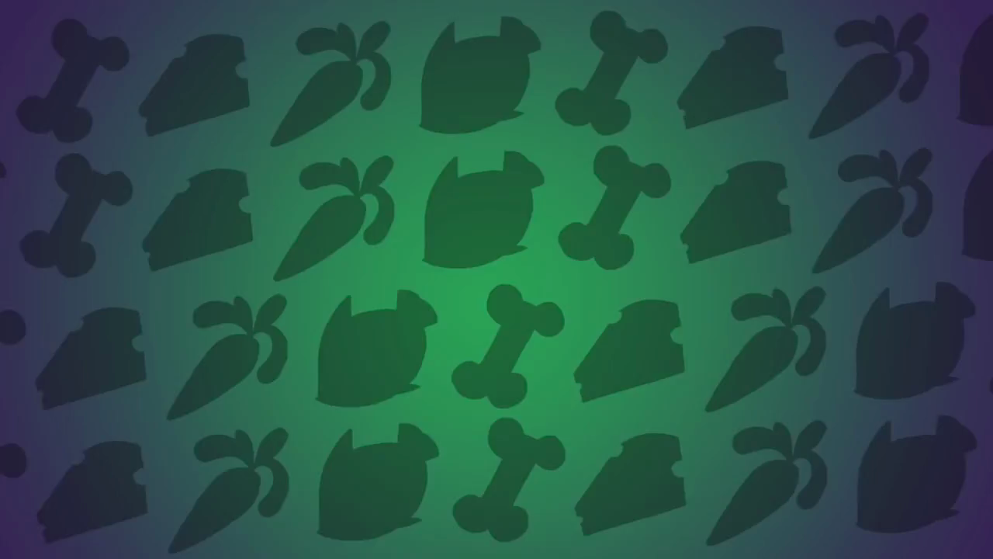
What is Feeding Time?
Notes:
URL to launch trailer: https://www.youtube.com/watch?v=Ewr1GrXO7gU

Slide 10
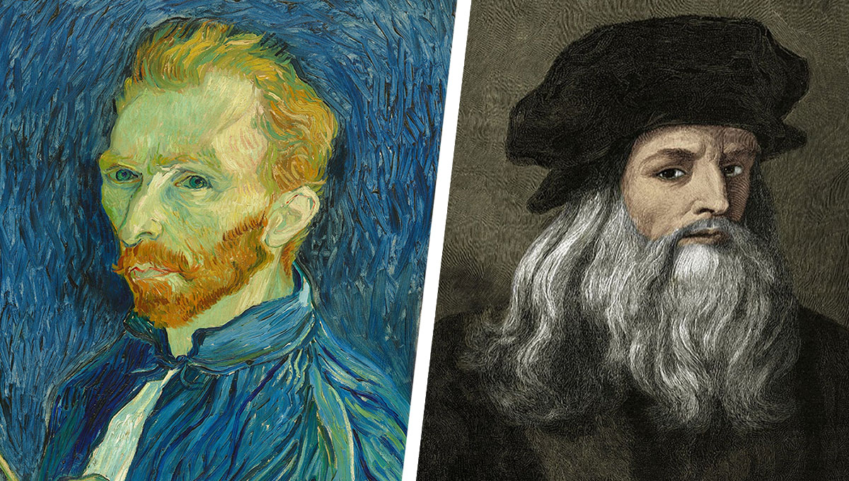
Freelance Artists

Slide 11
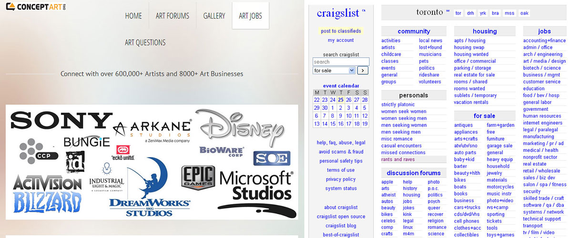
Freelance Artists
Relied on Freelance Illustrators From:
conceptart.org/go/artjobs/
craigslist.ca/search/med
Honourable mention goes to: kijiji.ca
Notes:
Indiegamer and other game-specific forums and sites did not yield results that were as good. Local talent useful for potential tax incentives.

Slide 12

Freelance Artists
75 -150 responses per ad collectively
Promoted ads received about 25% more responses
$20-$30/hour for junior artists, $30-$50/hour for experienced artists, $50+/hour for experts
Keep all submissions for potential future collaborations
Notes:
Possible to negotiate a set amount for individual pieces, but not practical for game development unless it’s just a boxshot/title screen.

Slide 13

Freelance Artists
Provide as much info as possible in ad:
  Payment amount, currency, delivery format
  Date and duration of project
  Request portfolio
Ask artist friends/previous hires to help gauge submissions
Ask for sample work
Notes:
Asking for samples is controversial, usually balked at by younger artists. Personally responded to these explaining our situation, and offered token payments to the finalists. However, getting samples is vital to not only gauge the artist’s skills and take on the game outside a portfolio, but also their responsiveness and communication skills -- almost 50% of the artists who agreed to the test never delivered and failed to respond to further e-mail inquiries.

Slide 14
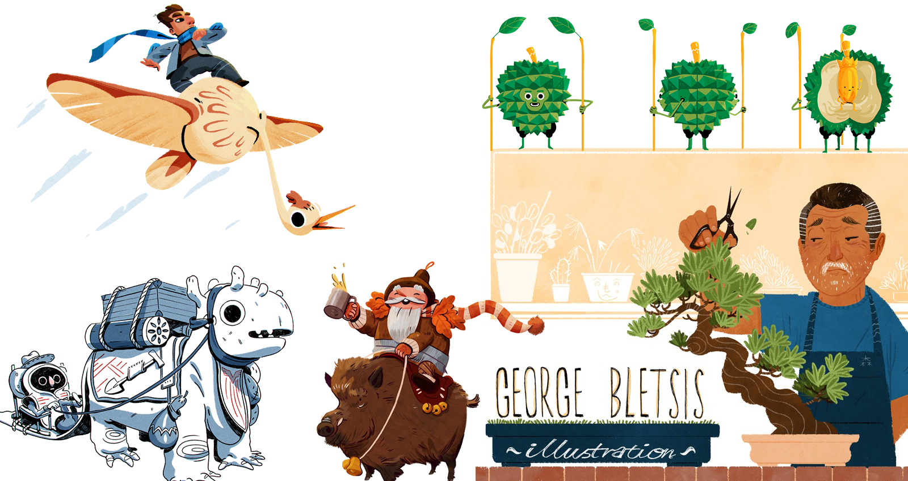
Freelance Artists
Feeding Time’s artist: George Bletsis
http://www.monstertree.co.uk/
Notes:
Something different from super glossy style, or untextured cartoony style with simple shapes and thick outlines.
Offered less strict delivery schedule and a large sum of work in the long term to compensate for slightly lower rates in the beginning. Still ended up paying $7,464

Slide 15
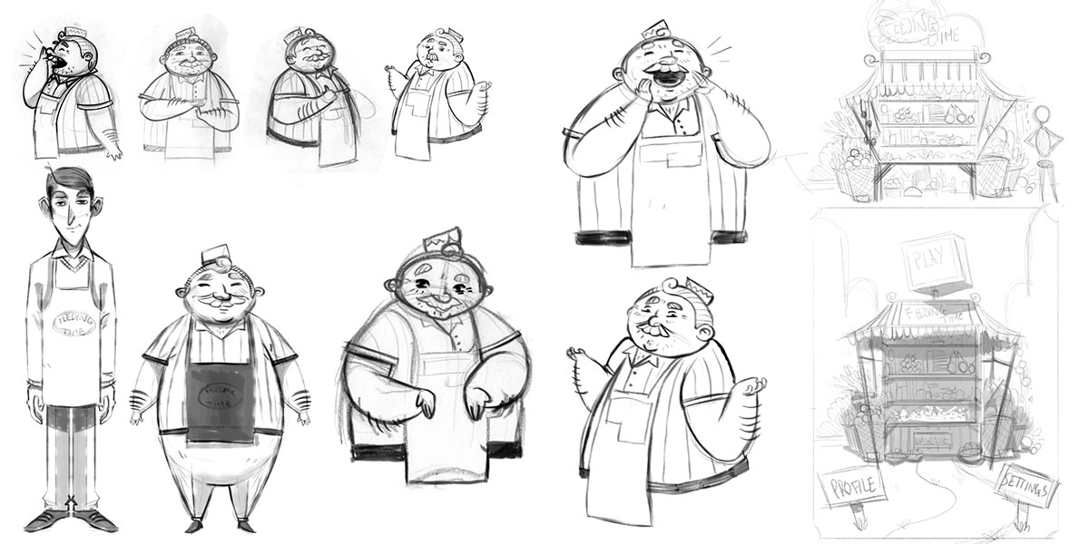
Visual Iteration
Notes:
Insert various Feeding Time sketches/concepts that are not used later on in the slides while avoiding the coloured parts.

Slide 16
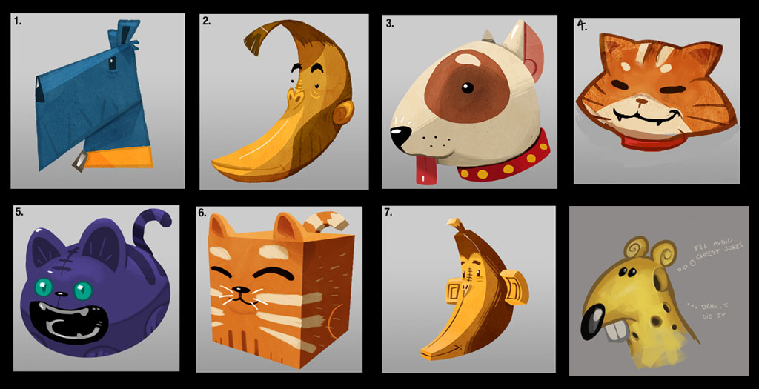
Visual Iteration - Animals
Initial Phase Involved Various Animal Concepts
Notes:
Main focus of the game would be animals and their foods, so decided to tackle those first. Early on we decided to only show animal heads due to space limitations.

Slide 17
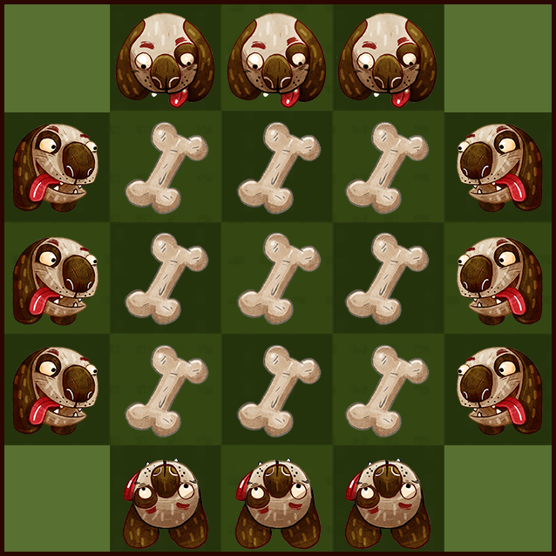
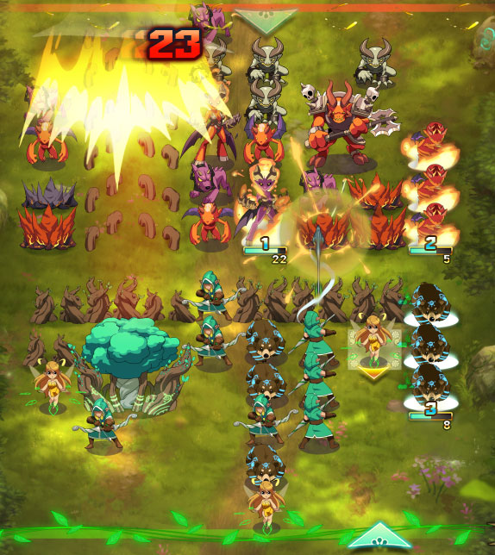
Visual Iteration - Animals
Facing Directions vs. One Angle
Notes:
Make dog and bone collage that includes a bigger board, at least 3x3 instead of one bone, not on black background.
Arbitrary angles helped capture the personality of each animal, especially when their shapes were similar, e.g., a fox and a wolf.

Slide 18
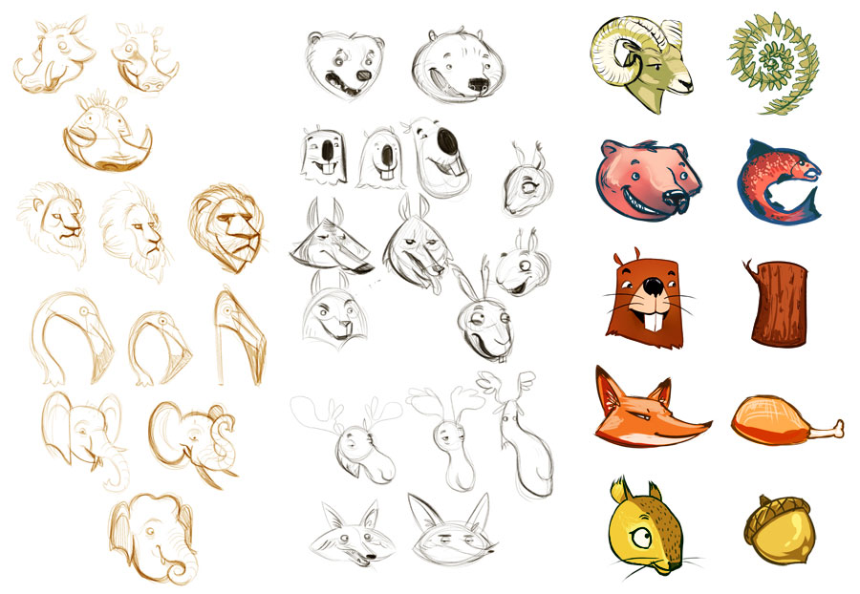
Visual Iteration - Animals
Settled on one Angle That Best Showcased the Animal and its Personality
Notes:
Animal silhouettes and colouring was designed to match its corresponding food even if it wasn’t accurate to real-life.

Slide 19
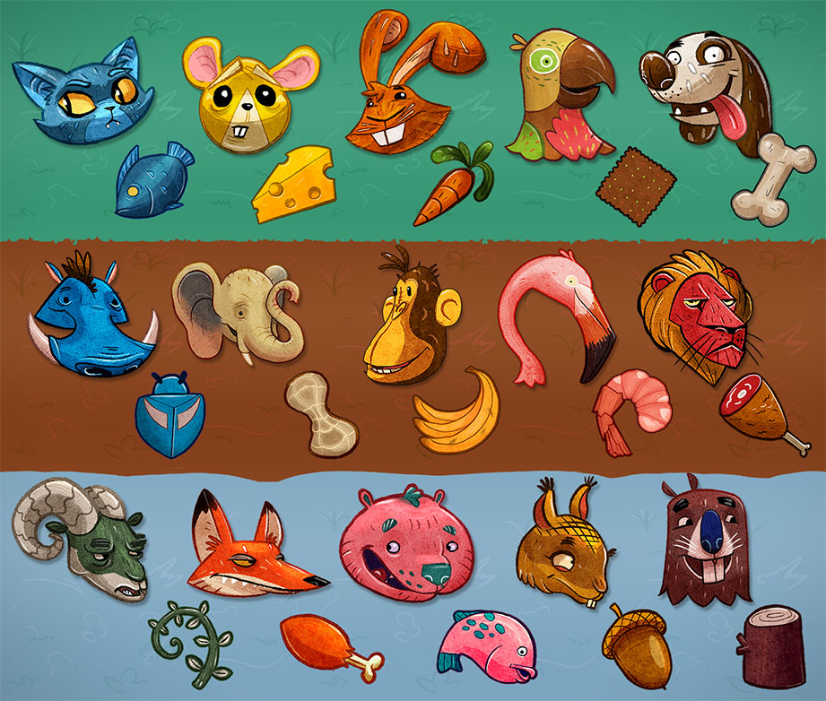
Visual Iteration - Animals
Notes:
Tried to keep things colourful and playful -- beaver eats logs – and keep contrast between the main bg colour.

Slide 20

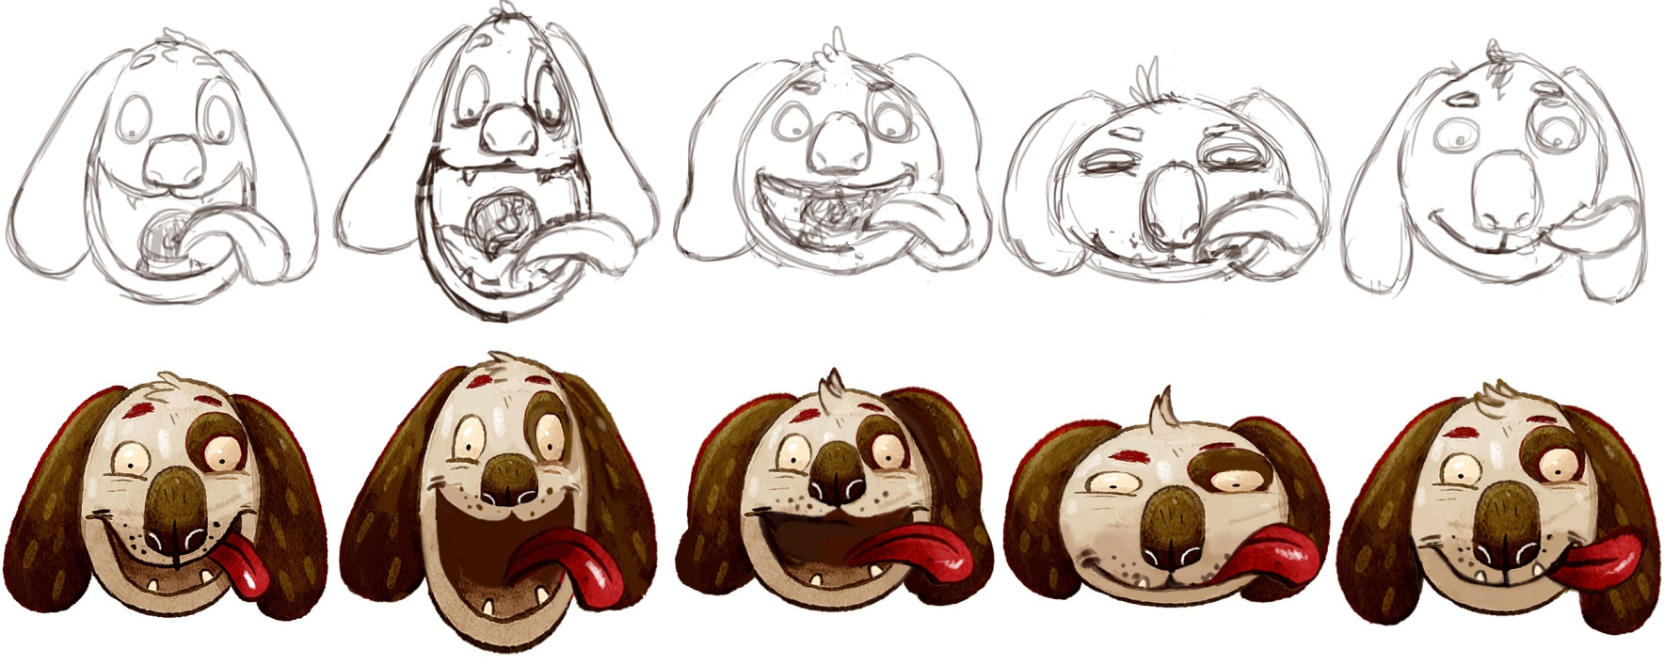
Visual Iteration - Animals
Animations Began Completely Hand-Drawn
Notes:
Created sketched frames then sliced original illustration into layers (ears, nose, eyes), then warped each layer to match its spot on the sketch.

Slide 21
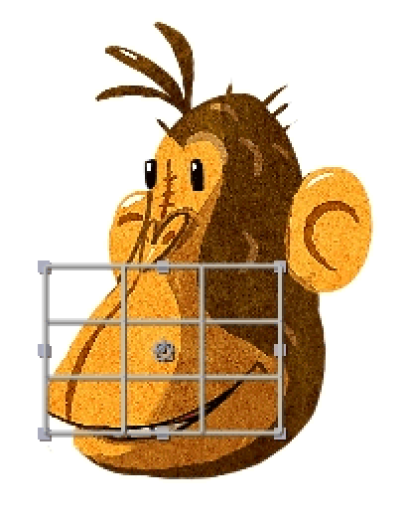
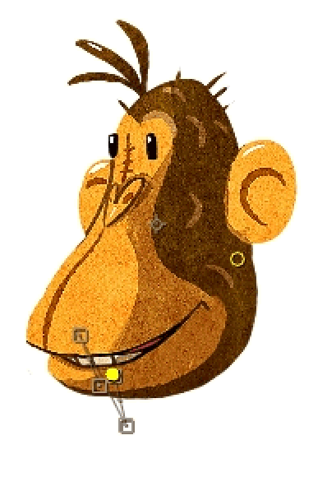
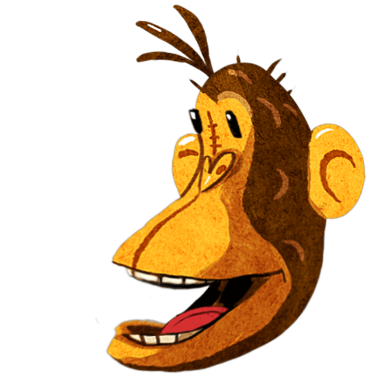
Visual Iteration - Animals
Second Approach Used Layer-Morphing
Notes:
Sleep, Happy, Idle, Sad, and Eat animations, sleep being cut.
Split image into upper-head, lower-jaw, teeth, and tongue. Warped and puppeteered these layers directly to make animations.

Slide 22
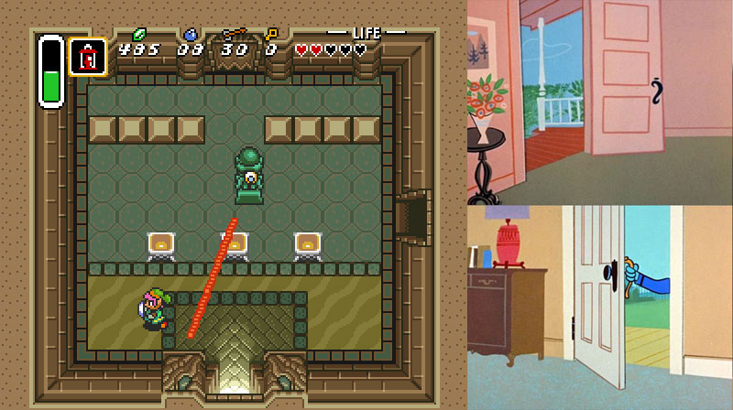
Visual Iteration - Backgrounds
Broken Perspective was Key to Backgrounds
Notes:
Looking down a well point-of-view caused too many issues with single-side animals.
Hanna Barbera cartoons’ abstract, broken perspective worked much better!

Slide 23
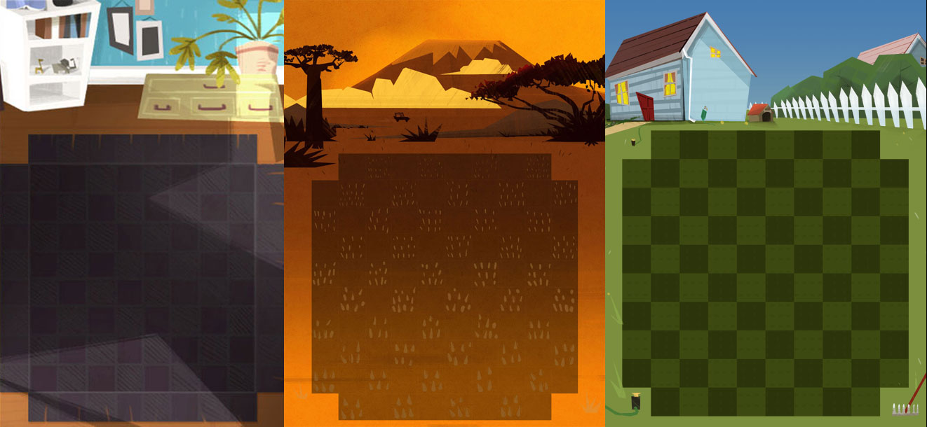
Visual Iteration - Backgrounds
The Grid Gave us Trouble
Notes:
Illustrated backgrounds without foods and animals was a mistake.

Slide 24
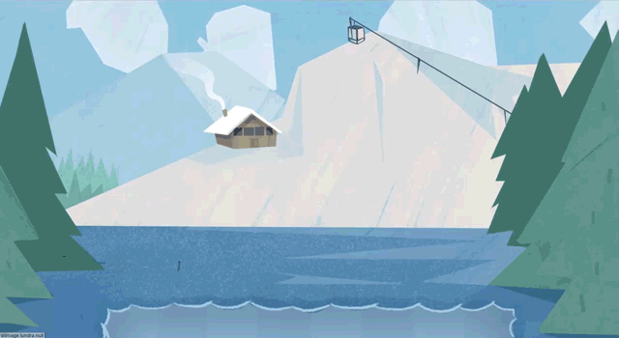
Visual Iteration - Backgrounds
Interactive Easter-Eggs Turned Into BG Anims
Notes:
Wanted bgs to be fun, so tried putting in easter eggs. All easter eggs turned into automated BG animations. None of these were film-stripped due to size constraints.

Slide 25
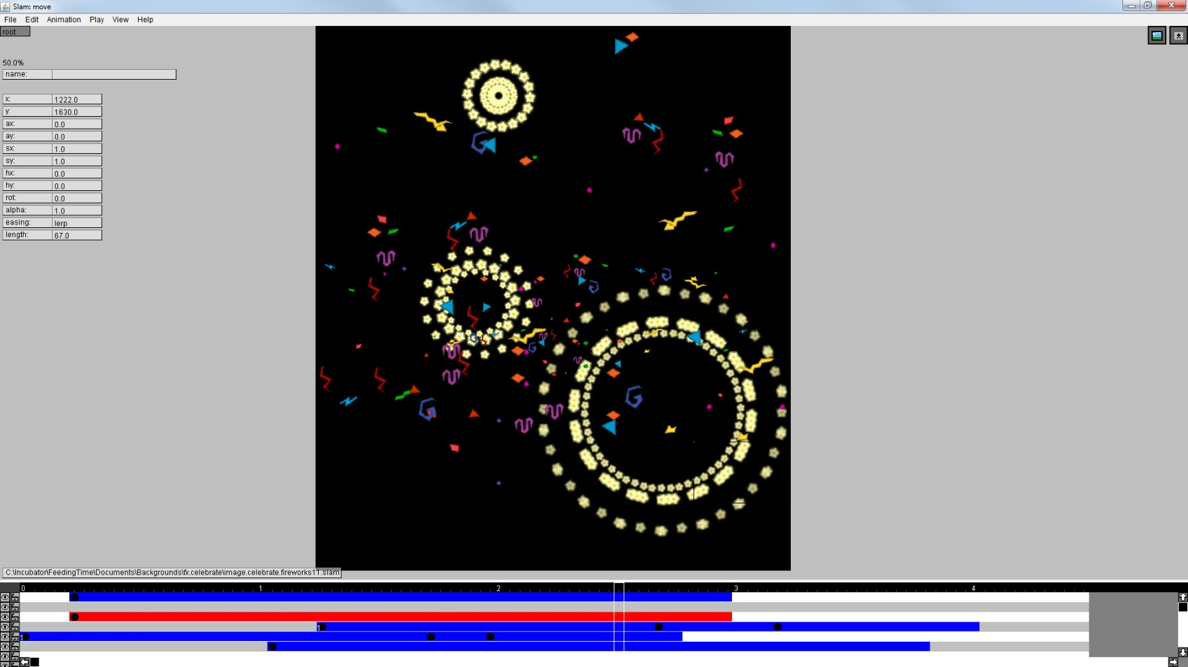
Visual Iteration - Backgrounds
SLAM, the Slick Animation Editor
Notes:
Used SLAMs instead, also came in handy for visual effects.

Slide 26
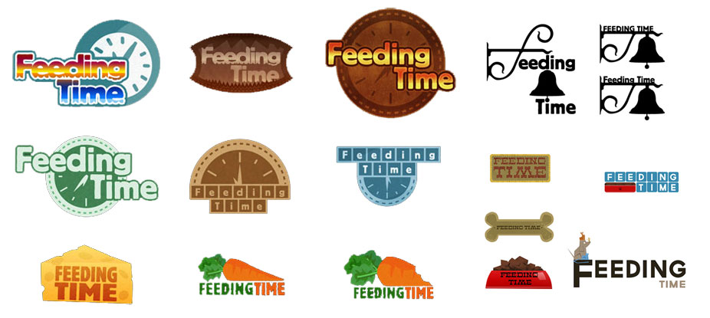
Visual Iteration - Branding & UI
Initial Logo Concepts
Notes:
Too clever, corporate, or relating to only one animal.

Slide 27
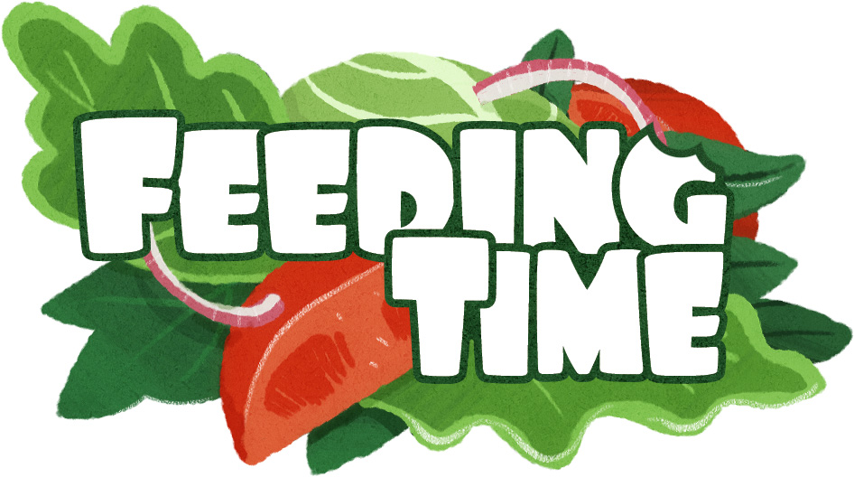
Visual Iteration - Branding & UI
Final Logo
Notes:
Appetizer salad, big bubbly letters, carrot bite mark on top-right corner.

Slide 28
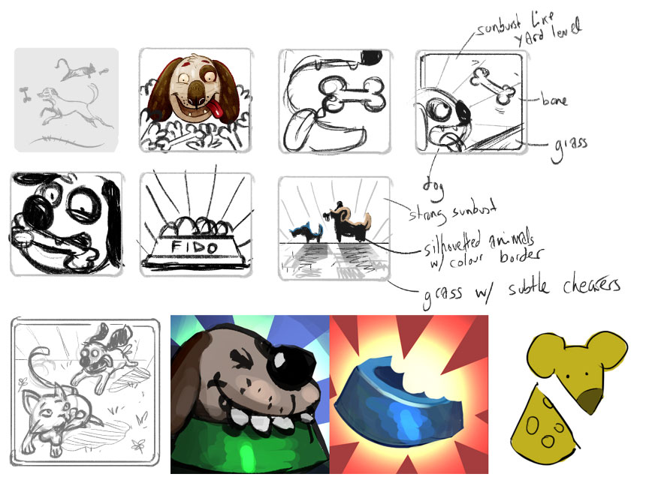

Visual Iteration - Branding & UI
App Icon Iteration
Used App Icon Template: http://appicontemplate.com/ios7
Notes:
Icon readability on different resolutions was a big concern.

Slide 29
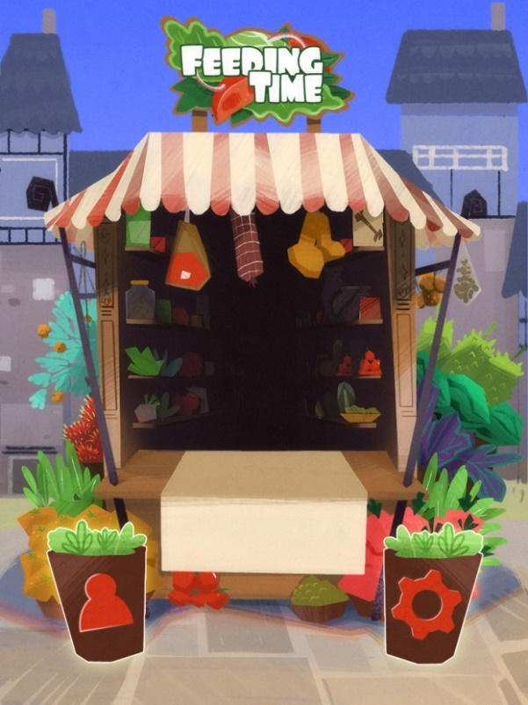
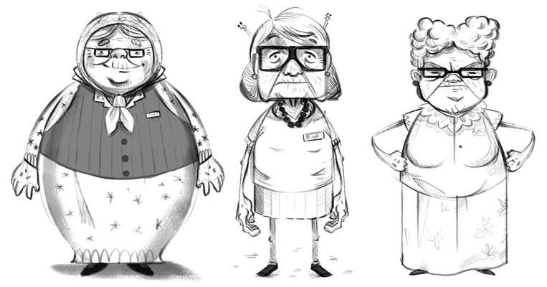
Visual Iteration - Branding & UI
The Starring Lady
Concepts for the Original Face of Feeding Time
Notes:
We wanted a stall clerk that would send the player on “feeding missions” around the world.

Slide 30
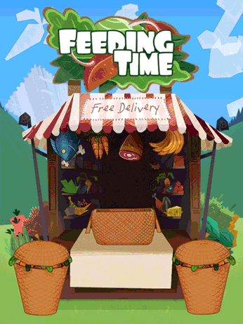
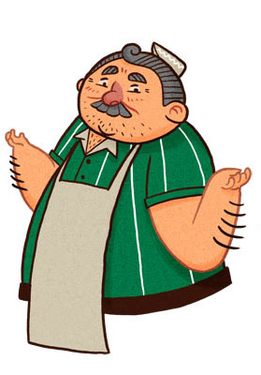
Visual Iteration - Branding & UI
The Controversial
Intro Cutscene
Notes:
A younger, male version of the clerk didn’t raise any eyebrows.

Slide 31
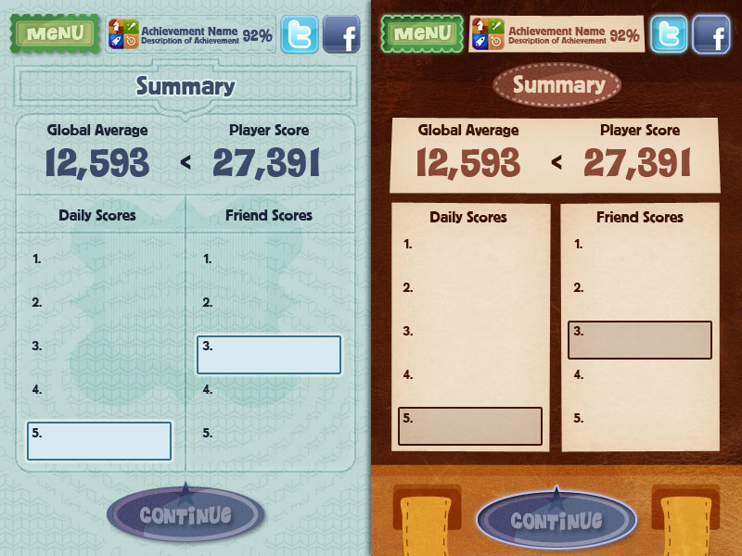
Visual Iteration - Branding & UI
Too Cold and Clinical, Hard to Animate

Slide 32
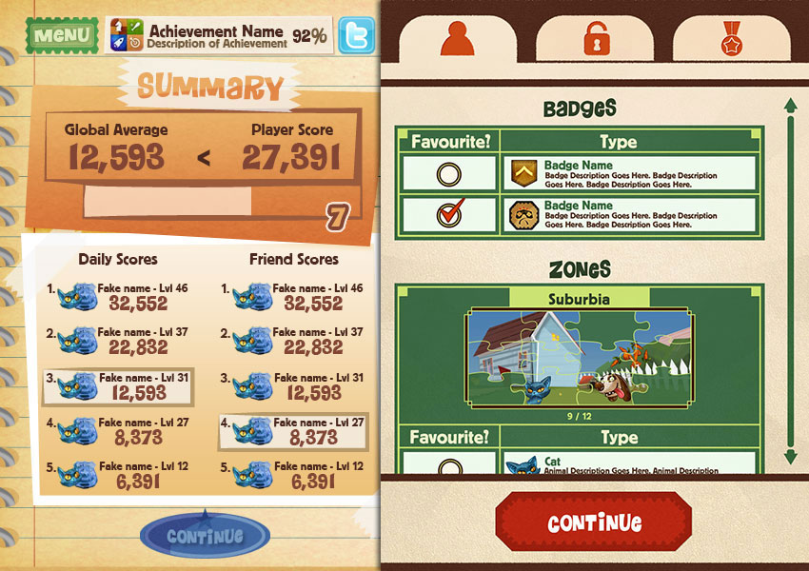
Visual Iteration - Branding & UI
Not a Good Fit Theme Wise, Too Formal

Slide 33
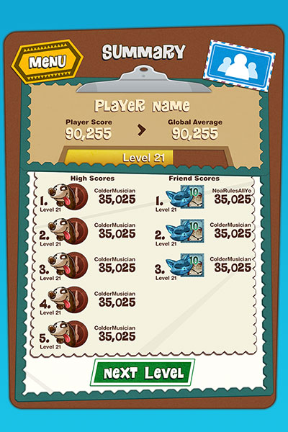
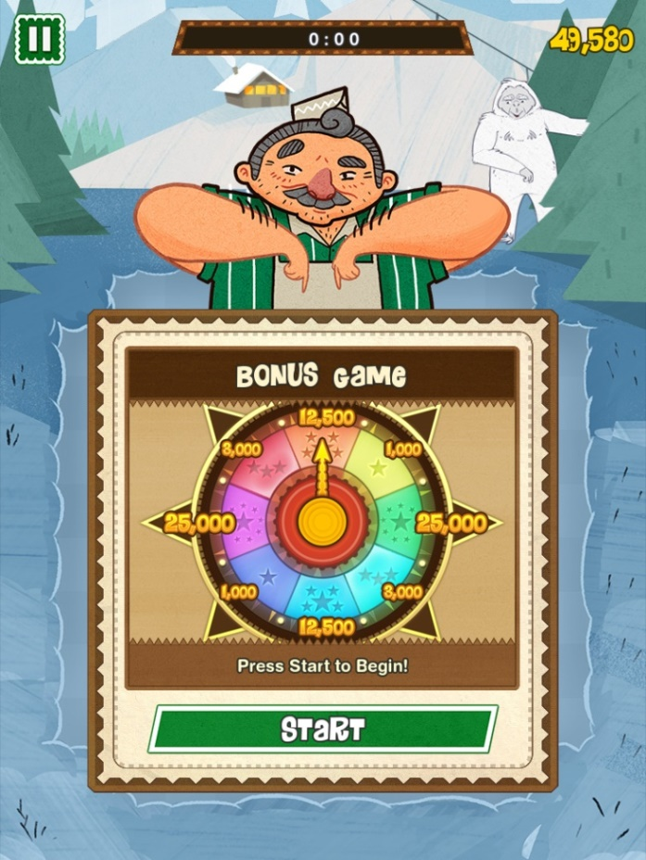
Visual Iteration - Branding & UI
Settled on Papercraft + Clerk

Slide 34
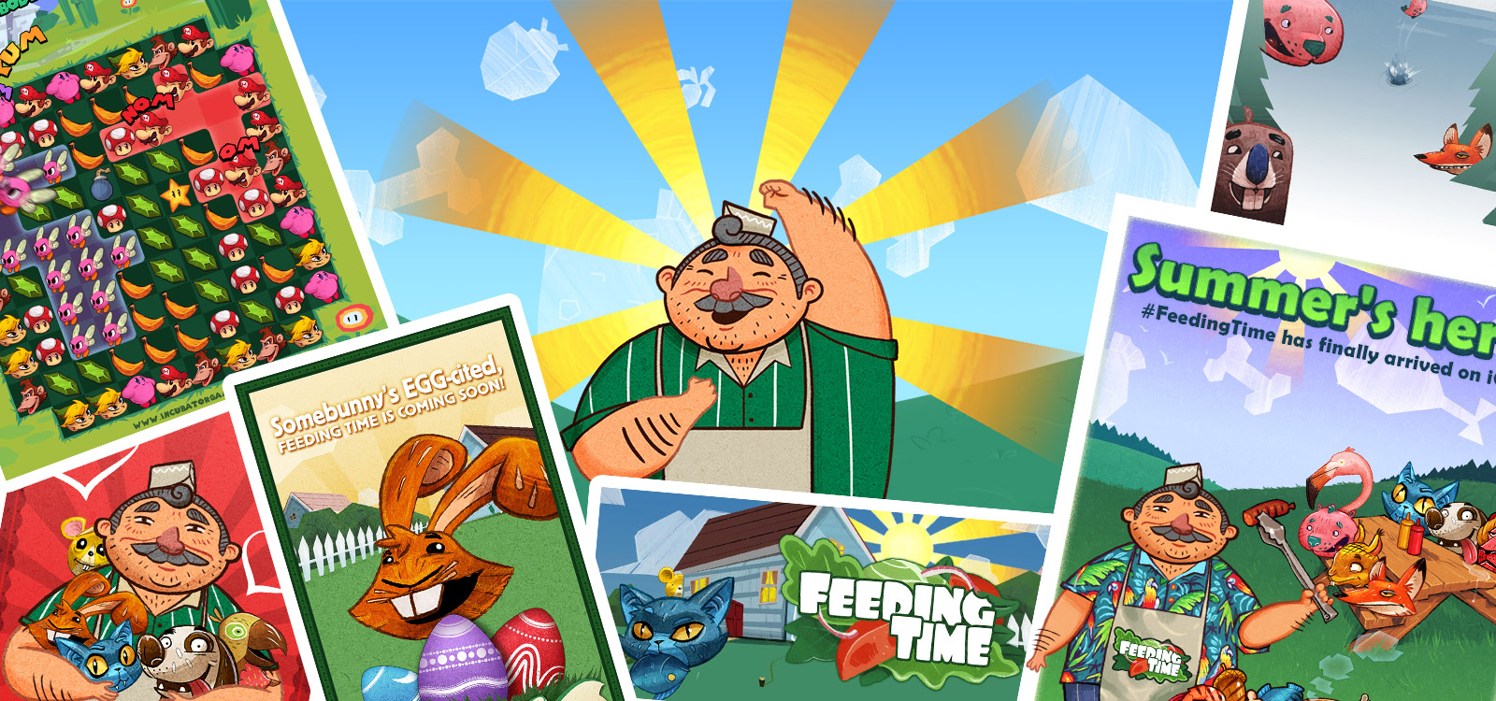
Promotional Content
Notes:
Insert collage of promo materials/sales posters/banners, other stock images (like the wacky inflatable waving arms thing from Family Guy?) Or use edited version of this website pic?
Original high-res images, 2048x2048, came in handy for website and other promo assets.

Slide 35
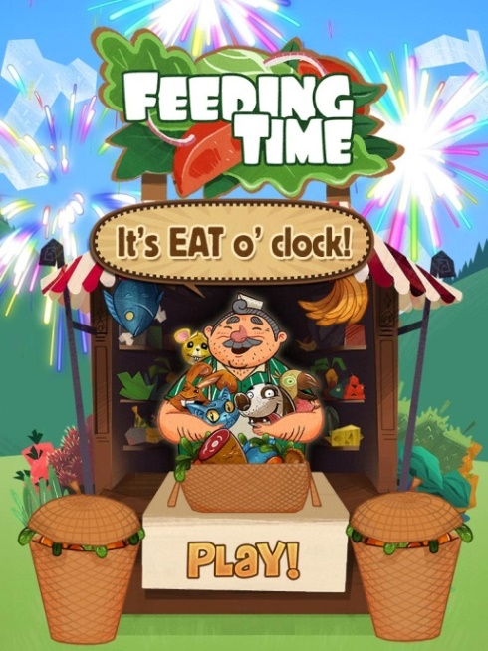
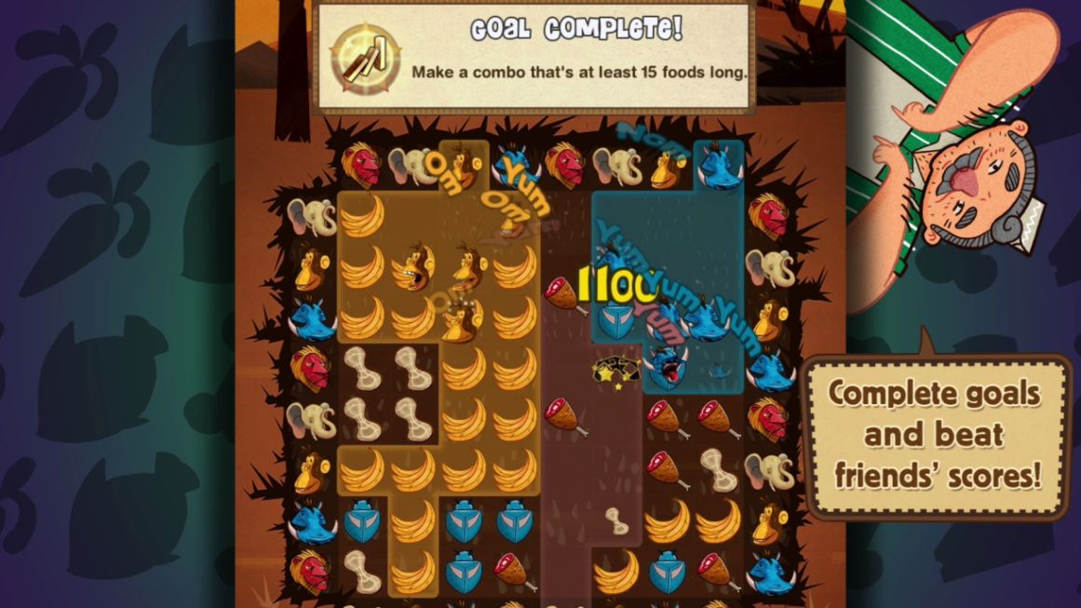
Promotional Content
Capture lots of screenshots at different resolutions
Include around 10 screens in 3 different resolutions for presskit purposes
Keep enhanced AppStore screenshots/trailers consistent with in-game visuals

Slide 36

Promotional Content
Twitter, tumblr, Facebook, YouTube, Google+:
2560x510
1500x500
975x325
940x370
800x150
Notes:
Lots of landscape-banners.

Slide 37
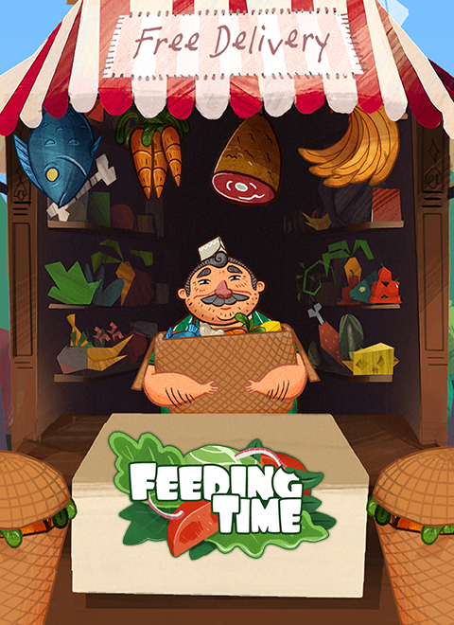
Promotional Content
SlideDB, Bandcamp, Contest
Submissions:
768x768
480x660
480x600
Notes:
Portrait box-art.

Slide 38
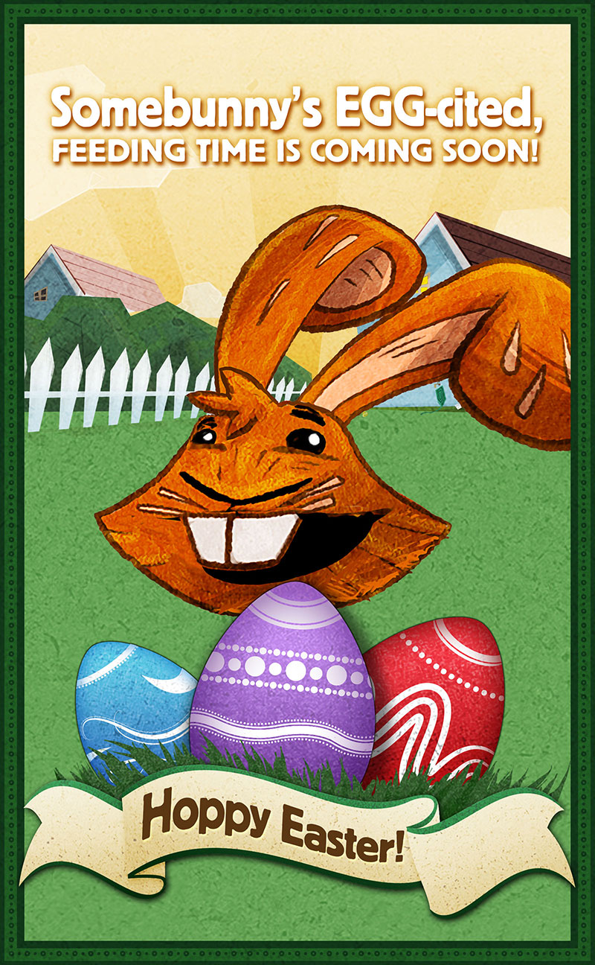
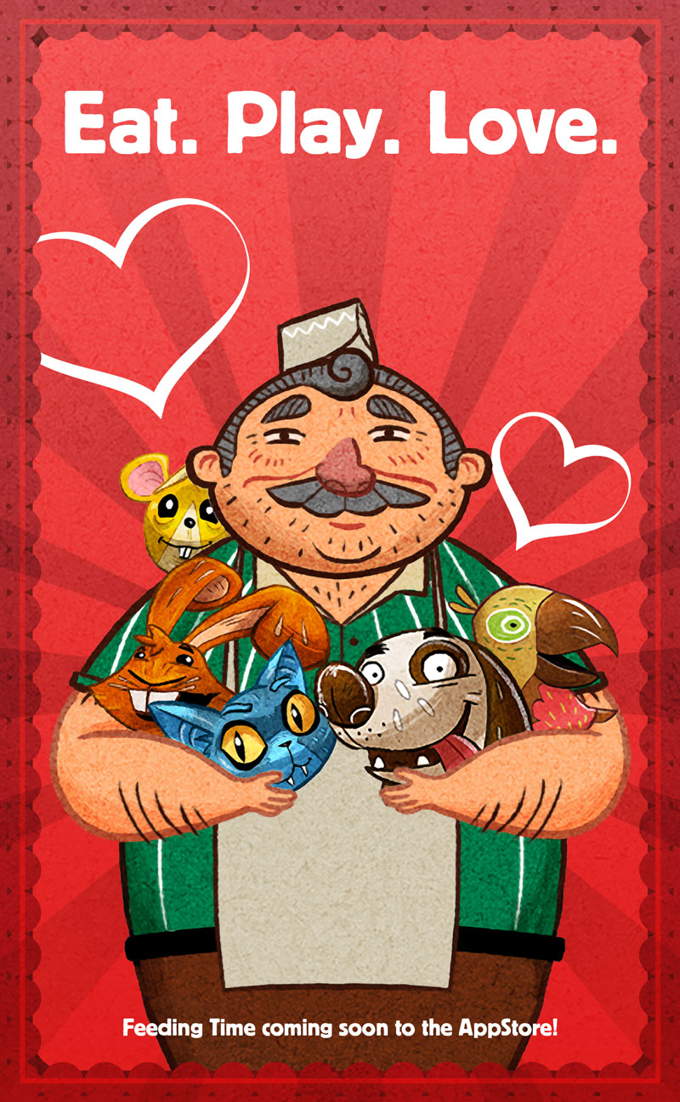
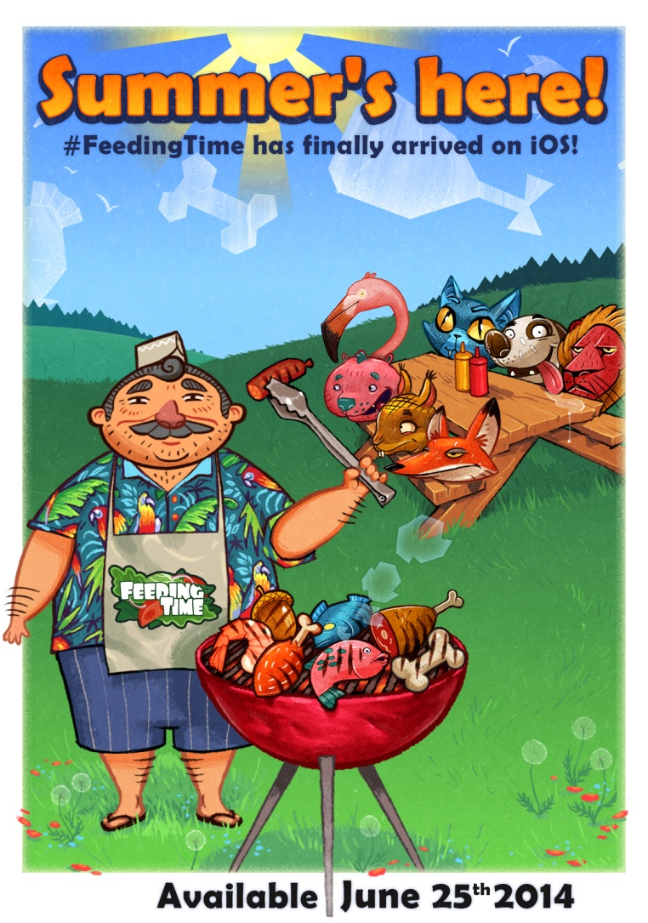
Promotional Content
Holiday Posters

Slide 39
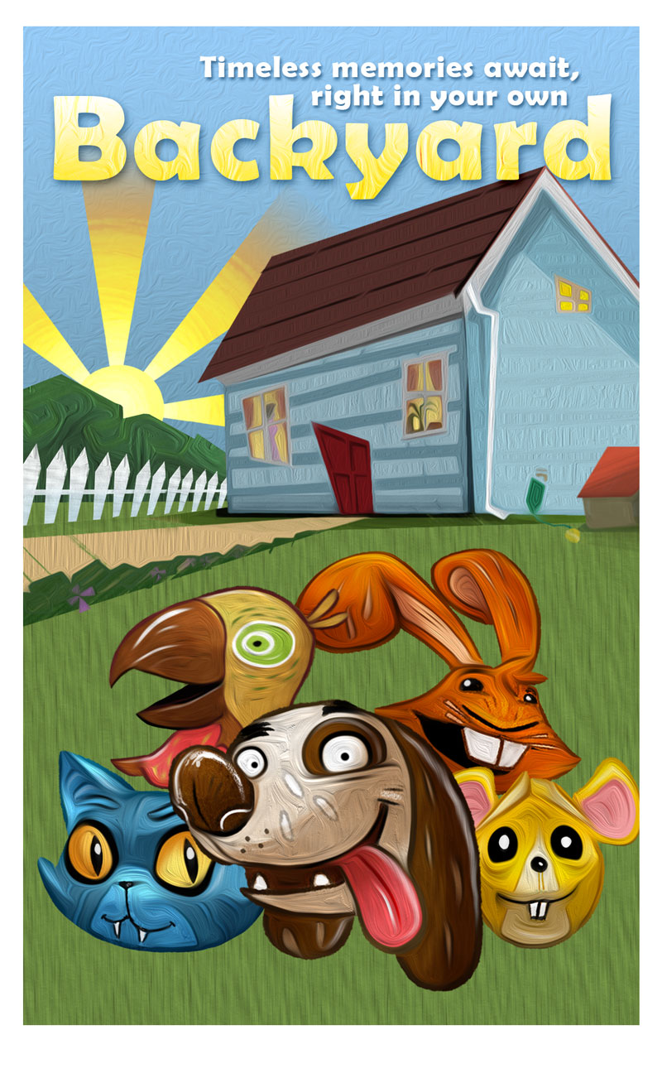
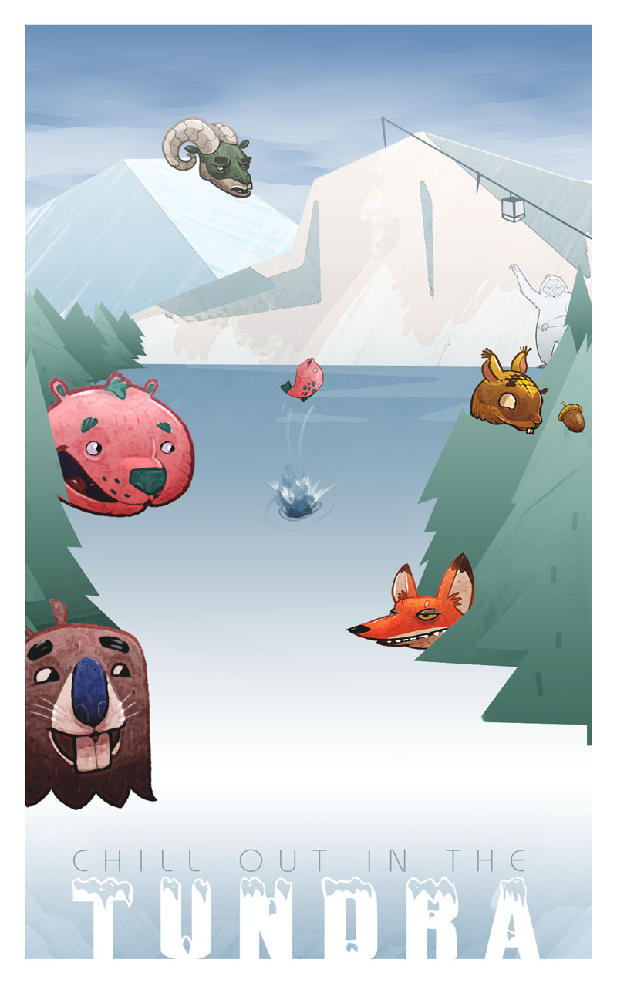
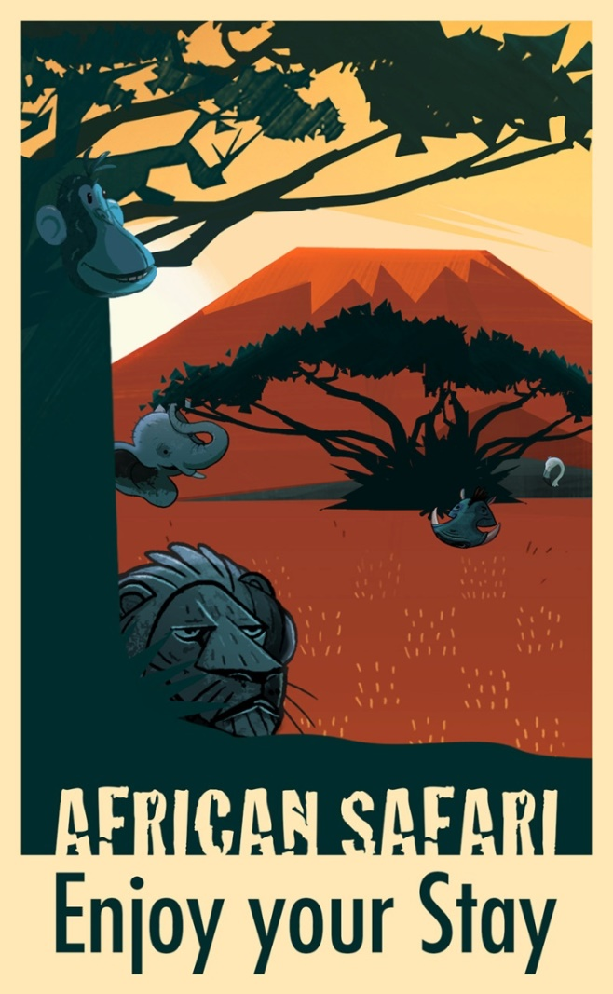
Promotional Content
Travel Posters

Slide 40
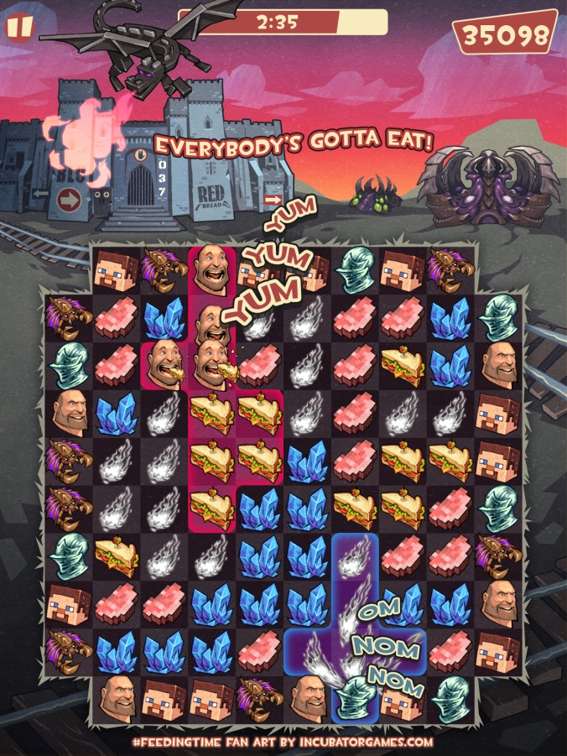
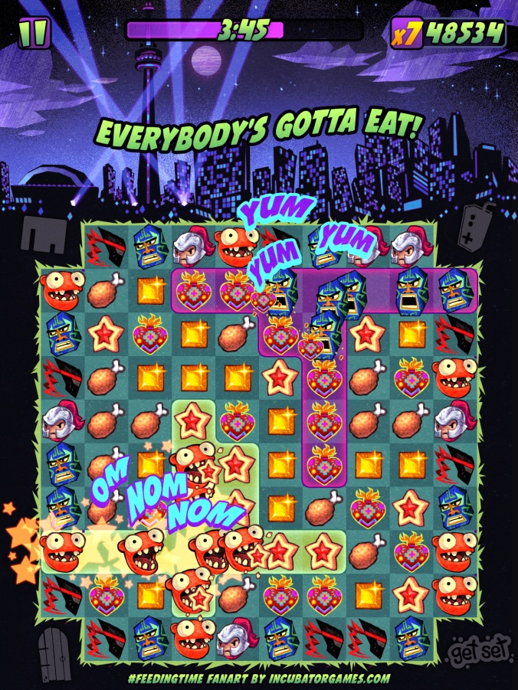
Promotional Content
Mashup Posters

Slide 41
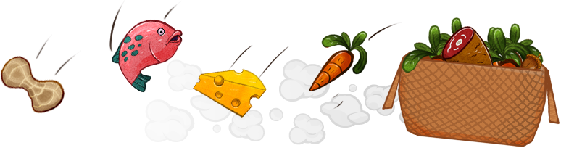
Final Takeaways
Notes:
Not sure if we need a splash here, if so what would it be?

Slide 42
Final Takeaways
Spent too much time iterating on UI too early in development
You’ll never please everyone
High-res assets in universal bundle were a mistake
Don’t wait to contact the press

Slide 43


Slide 44
Q & A

